Slide 1
Project 1
Account ID : 013617123040

Slide 2
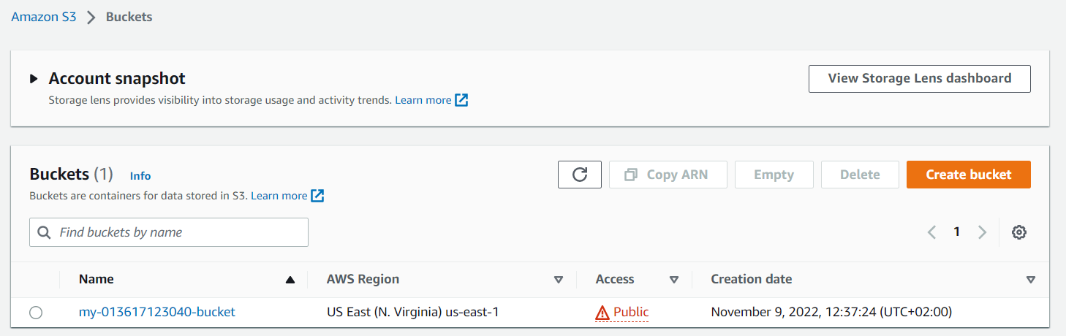
The S3 bucket:-

Slide 3
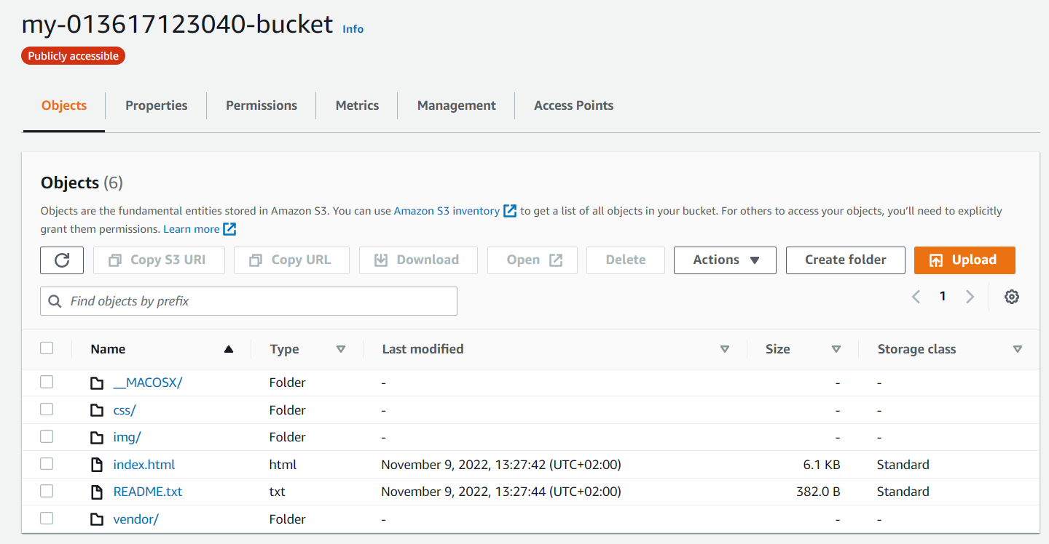
uploaded files to S3 bucket

Slide 4
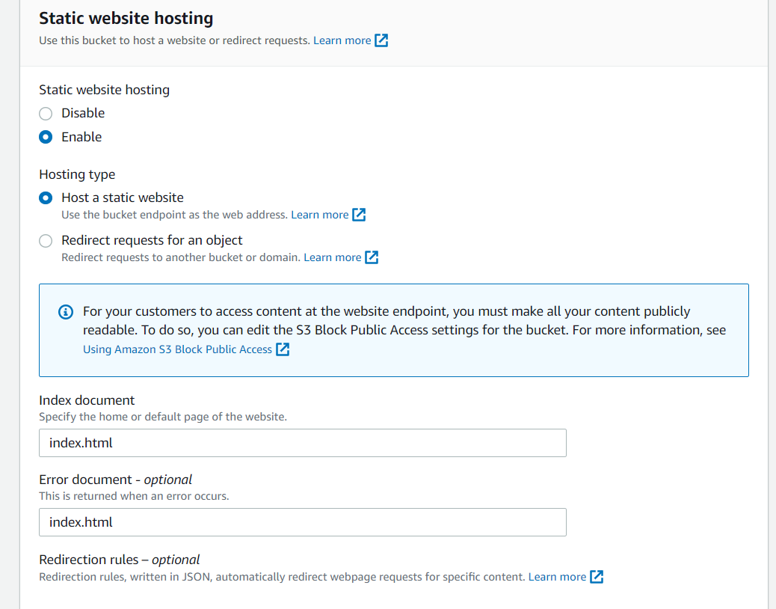
The S3 bucket is support static website hosting

Slide 5
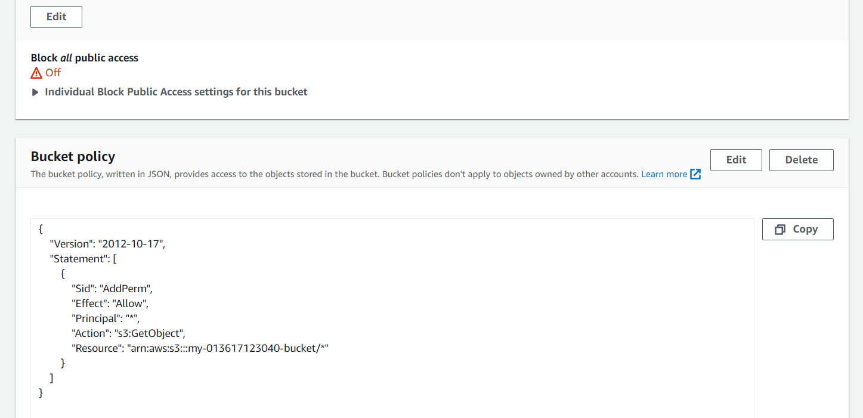
The S3 bucket has an IAM bucket policy that makes the bucket contents publicly accessible.

Slide 6
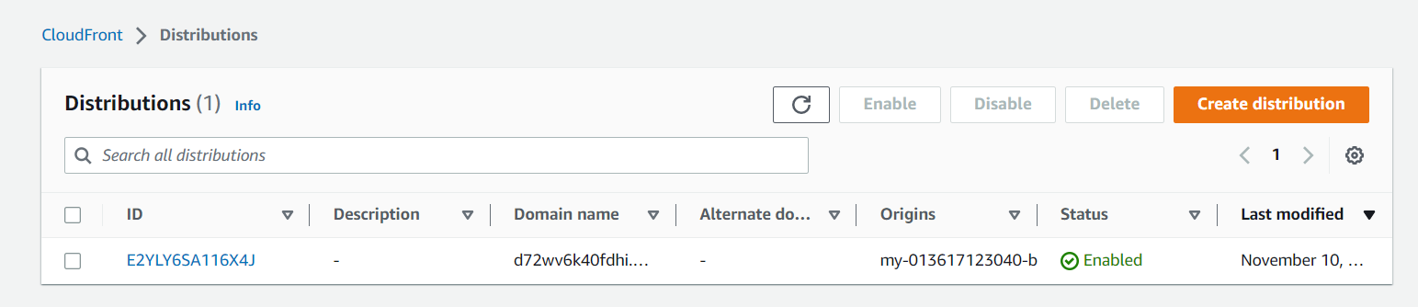
CloudFront has been congured to retrieve and distribute website les.

Slide 7
URLS:-
1-for cloudfront : https://d72wv6k40fdhi.cloudfront.net/
2-Access the website via website-endpoint: http://my-013617123040-bucket.s3-website.us-east-1.amazonaws.com/
2-Access the bucket object via its S3 object URL:
https://my-013617123040-bucket.s3.amazonaws.com/index.html

Slide 8
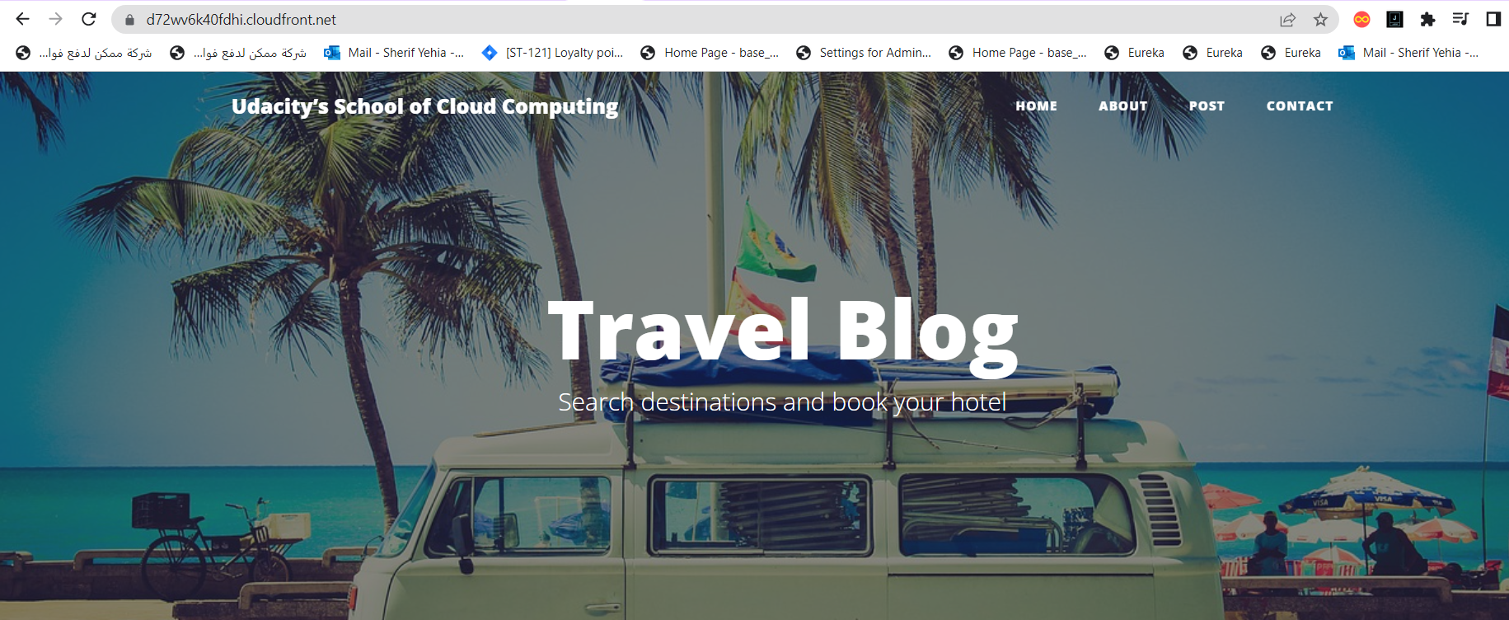

Slide 9
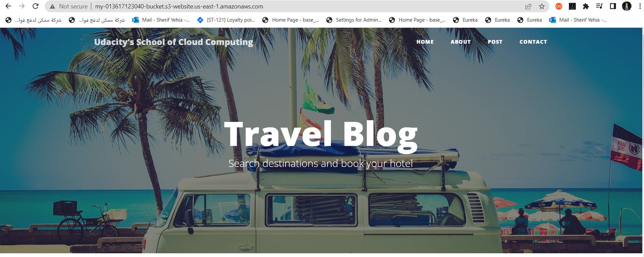

Slide 10
